Slide 1
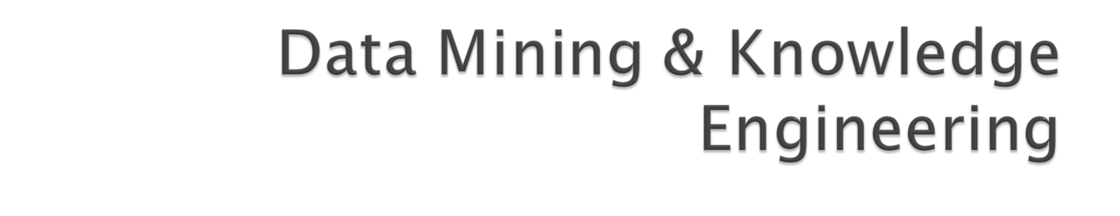
Session 1
Course Overview and Introduction

Slide 2

Formulate a definition of Data Mining
Examine the different types of Structural Descriptions
Discuss a framework for Knowledge Discovery
Examine some landmark successes

Slide 3

Society produces huge amounts of data
Sources: business, science, medicine, economics, geography, environment, sports, …
Potentially valuable resource
Raw data is useless: need techniques to automatically extract information from it
Data: recorded facts
Information: patterns underlying the data

Slide 4
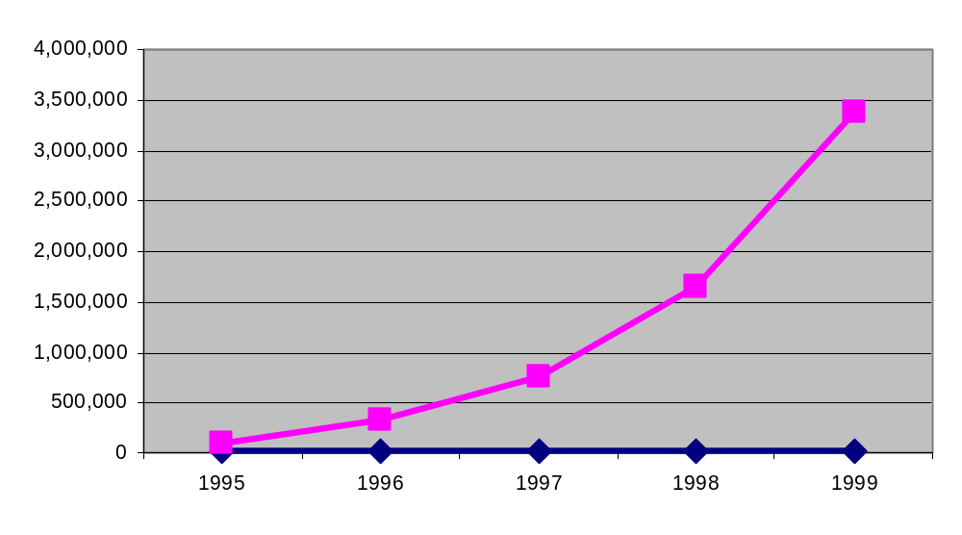
There is often information “hidden” in the data that is
not readily evident
Human analysts may take weeks to discover useful information
Much of the data is never analyzed at all
The Data Gap
Total new disk (TB) since 1995
Number of analysts
From: R. Grossman, C. Kamath, V. Kumar, “Data Mining for Scientific and Engineering Applications”

Slide 5
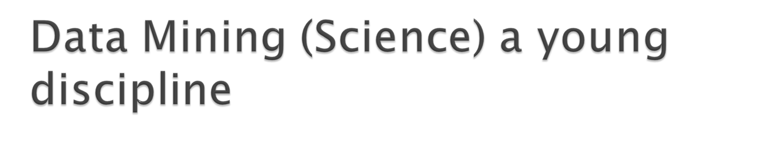
Emerged in the mid 1990’s and has grown rapidly world-wide.
Professionals referred to by a number of different names: data scientists, information scientists, data analysts, etc.
Kaggle (www.kaggle.com) has more then 93,000 data scientists registered world-wide
DataMine (http://www.datamine.com) a local company (with International branches) specializes in providing Data Mining consultancy services to clients
Many other companies have in-house Data Analysts

Slide 6

Example 1: customer credit risk
Given: customers described by features such as income, debt level, etc.
Problem: selection of prospective customers that represent a good credit risk
Data: historical records of customers and their loan payment details
Example 2: cow culling
Given: cows described by 700 features
Problem: selection of cows that should be culled
Data: historical records and farmers’ decisions

Slide 7

Extraction of implicit, previously unknown, and potentially useful information from data
Needed: programs that detect patterns and regularities in the data
Strong patterns can be used to make predictions
Problem 1: most patterns are not interesting
Problem 2: patterns may be inexact (or even
completely spurious) if data is garbled or missing

Slide 8

What is not Data Mining?
  Look up phone number in phone directory
  Query a Web search engine for information about “Amazon”
What is Data Mining?
  Certain names are more prevalent in certain US locations (O’Brien, O’Rurke, O’Reilly… in Boston area)
  Group together similar documents returned by search engine according to their context (e.g. Amazon rainforest, Amazon.com,)

Slide 9

Draws ideas from machine learning/AI, pattern recognition, statistics, and database systems
Traditional Techniques
may be unsuitable due to
  Enormity of data
  High dimensionality
  of data
  Heterogeneous,
  distributed nature
  of data
Statistics/
AI
Machine Learning/
Pattern
Recognition
Data Mining
Database systems

Slide 10

Technical basis for data mining: algorithms for acquiring structural descriptions from examples
Structural descriptions represent patterns explicitly
Can be used to predict outcome in new situation
Can be used to understand and explain how prediction is derived (maybe even more important)
Methods originate from both artificial intelligence and statistics

Slide 11

Given a collection of records (training set )
  Each record contains a set of attributes, one of the attributes is the class.
Find a model for class attribute as a function of the values of other attributes.
Goal: previously unseen records should be assigned a class as accurately as possible.
  A test set is used to determine the accuracy of the model. Usually, the given data set is divided into training and test sets, with training set used to build the model and test set used to validate it.

Slide 12



categorical
categorical
continuous
class
Test
Set
Learn
Classifier
Training
Set
Model

Slide 13

Direct Marketing
  Goal: Reduce cost of mailing by targeting a set of consumers likely to buy a new cell-phone product.
  Approach:
    Use the data for a similar product introduced before.
    We know which customers decided to buy and which decided otherwise. This {buy, don’t buy} decision forms the class attribute.
    Collect various demographic, lifestyle, and company-interaction related information about all such customers.
      Type of business, where they stay, how much they earn, etc.
    Use this information as input attributes to learn a classifier model.

Slide 14

Fraud Detection
  Goal: Predict fraudulent cases in credit card transactions.
  Approach:
    Use credit card transactions and the information on its account-holder as attributes.
      When does a customer buy, what does he buy, how often he pays on time, etc
    Label past transactions as fraud or fair transactions. This forms the class attribute.
    Learn a model for the class of the transactions.
    Use this model to detect fraud by observing credit card transactions on an account.

Slide 15

Customer Attrition/Churn:
  Goal: To predict whether a customer is likely to be lost to a competitor.
  Approach:
    Use detailed record of transactions with each of the past and present customers, to find attributes.
      How often the customer calls, where he calls, what time-of-the day he calls most, his financial status, marital status, etc.
    Label the customers as loyal or disloyal.
    Find a model for loyalty.

Slide 16
Sky Survey Cataloging
  Goal: To predict class (star or galaxy) of sky objects, especially visually faint ones, based on the telescopic survey images (from Palomar Observatory).
      3000 images with 23,040 x 23,040 pixels per image.
  Approach:
    Segment the image.
    Measure image attributes (features) - 40 of them per object.
    Model the class based on these features.
    Success Story: Could find 16 new high red-shift quasars, some of the farthest objects that are difficult to find!

Slide 17




Courtesy: http://aps.umn.edu
Early
Class:
Stages of Formation
Attributes:
Image features,
Characteristics of light waves received, etc.
Intermediate
Late
Data Size:
72 million stars, 20 million galaxies
Object Catalog: 9 GB
Image Database: 150 GB

Slide 18
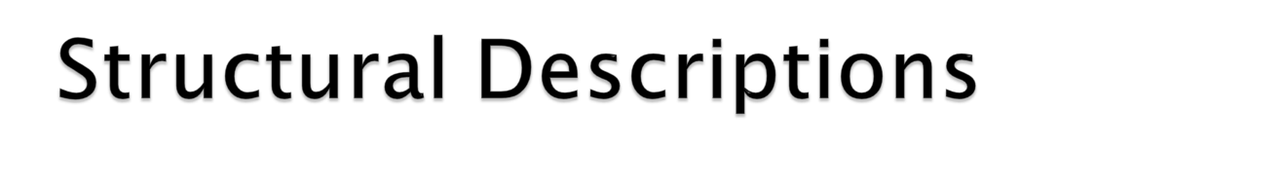
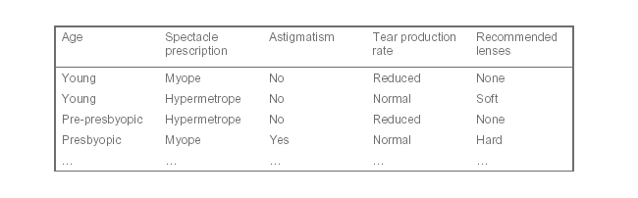
if-then rules
If tear production rate = reduced
then recommendation = none
Otherwise, if age = young and astigmatic = no then recommendation = soft

Slide 19

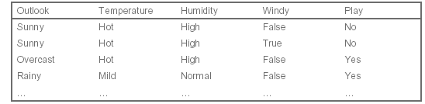
Conditions for playing a game
If outlook = sunny and humidity = high then play = no
If outlook = rainy and windy = true then play = no
If outlook = overcast then play = yes
If humidity = normal then play = yes
If none of the above then play = yes

Slide 20

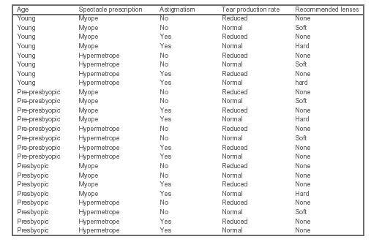

Slide 21
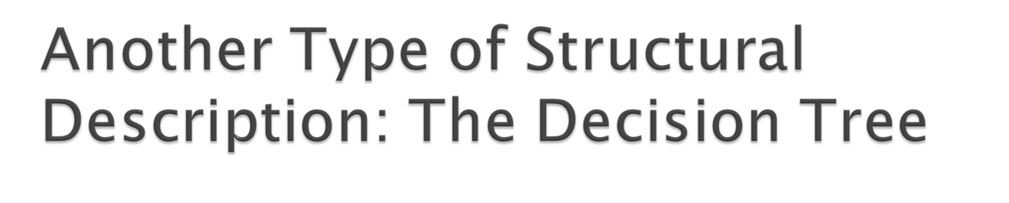
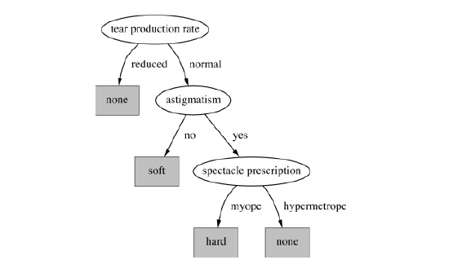

Slide 22

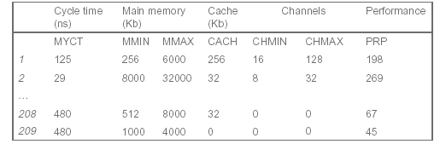
Examples: 209 different computer configurations
PRP = -55.9 + 0.0489 MYCT + 0.0153 MMIN + 0.0056 MMAX
+ 0.6410 CACH - 0.2700 CHMIN + 1.480 CHMAX

Slide 23

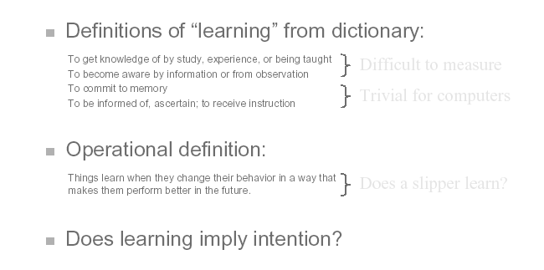

Slide 24

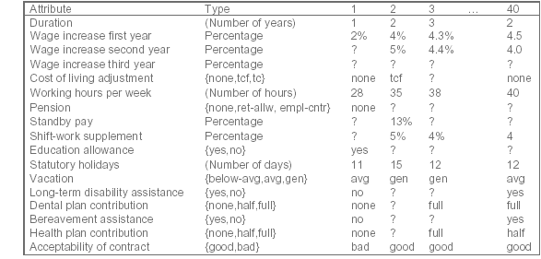

Slide 25
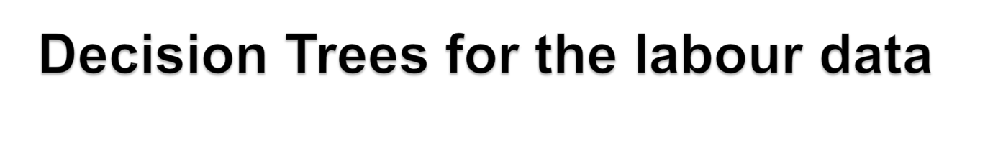
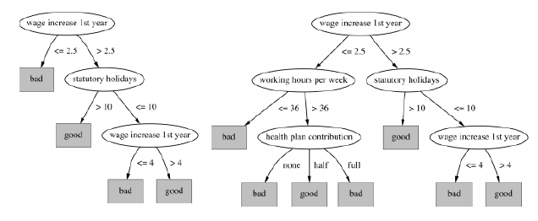

Slide 26

Bias can arise in two different contexts:
  Search bias
  Over-fitting bias
Search Bias
In most DM problems it is computationally infeasible to search the entire solution space
Thus heuristic methods are generally used
For example a greedy method of rule discovery would work by finding the best rule at each stage and add it to its rule set
Another type of search bias arises from the basic type of search used – general-to-specific or specific-to-general

Slide 27

Here we avoid building models that reflect the given data set (sample) too closely
There is then a danger that it captures details that may not be true of other samples from the same population
Thus the DM model is unable to generalize – i.e. it will be unable to effectively make predictions on new data
This problem can be avoided by using a “simplest first” search strategy
Here we search the concept space starting with the simplest concept descriptions and proceed to more complex ones later, stopping the search when a sufficiently complex description has been found

